Slide 1
RIGHT RESOURCE KENYA LTD
PROFILE
www.rightresource.co.ke

Slide 2
Who we are
Right Resource Kenya Limited is a private limited company registered under Kenya Laws. We specialize in human resource, Accounting & business set-up consultancy services. We transform how Large, SMEs & Start-Up companies approach business with the aim of offloading non-core activities/ functions, improving on business stability, increased productivity, employee retention, compliance, effective management of workforce and ensuring conducive work environment that allows employee to improve on performance.
We provide services in key functional areas of Human Resource and Company Registration & secretarial services.
Our Services Include;
Recruitment, selection & Onboarding,
Workforce Training ,
Human Resource Management Outsourcing,
Manpower Outsourcing,
HR Audit,
Payroll administration
Finance, Accounting & Taxation
Ltd Company Registration & Business set-up ( Start Up)
www.rightresource.co.ke

Slide 3
What we stand for
Our Core Values
Confidentiality
Professionalism
Honest
Integrity
Mission
Working with our clients to build the capabilities that enable them achieve sustainable advantage. We are shaping the future together.
Vision
To become the preferred business management consultancy firm for investors and entrepreneurs globally.
www.rightresource.co.ke

Slide 4
Our services
✵ Recruitment, Selection & Onboarding
We know how important it is to get the right employee for the role and we know how much time and effort that process takes. Right Resource ltd offers a dedicated recruitment service that has been designed to reduce the time you spend on recruitment, from sourcing the right people for the job to onboarding them.
Our recruitment execution phase entails the following:
Candidate Sourcing
Candidate Screening
Interviews
Background Checks
Contracting &
On boarding
www.rightresource.co.ke

Slide 5
Our services
How we execute our recruitment exercise
Fixed rate: We charge a flat rate regardless of the role that you recruit, meaning that we do not take extensive percentage of salary
Vacancy listing: We target our advertising across all of the major recruitment sites and job boards.
CV screening: We ensure that only the most suitable applicants make it through to the interview.
Job Description: We will assist you in preparing a job description for the role in line with your business needs.
Arranging interviews: We screen and shortlist the most suitable candidates prior to meeting with you for the final interview.
Interview feedback: We ensure all the interviewed candidates get feedback after the interview.
www.rightresource.co.ke

Slide 6
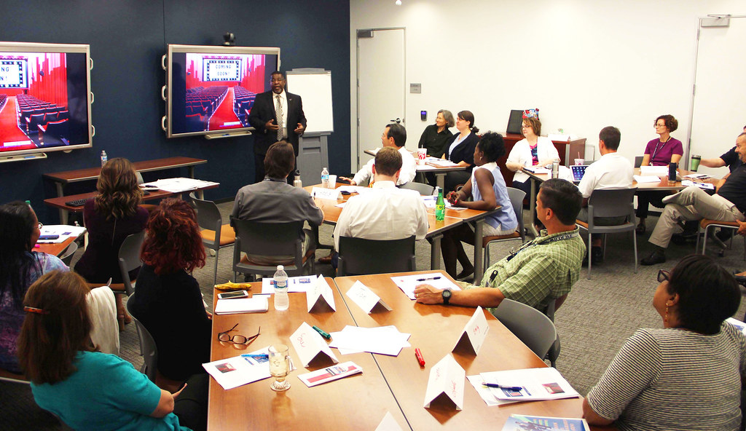
Our services
✵ Training & development
Employee training and development programs are essential to the success of businesses worldwide. Not only do these programs offer opportunities for staff to improve their skills, but also for employers to enhance employee productivity and improve company culture.
Some benefits of employee training & development to the employer
Training & development attracts young and energetic employees,
Through training, workers become more loyal and committed to your organization
Training promotes talent retention.
Training improves competency, flexibility and efficiency of your employees
Employee training is a knowledge transfer tool
Training equips employees with the skills required to run the business better.
www.rightresource.co.ke

Slide 7
Our services
Human Resource Outsourced Services
HR outsourced services are meant to convert the HR department fixed cost into variable costs. Your company can invest effectively in the core business activities while letting us professionally manage the human resource functions.
How we do it;
We assign a dedicated HR consultant who will visit your office at agreed specific periods of time.
We offer a complete start-to-end HR administration and management
We develop, monitor and implement the HR operating policies & procedures.
We ensure that all your employee files are well maintained in physical & soft files with all requirements being up-to date.
We maintain your staff’s leave records and ensure that it is in line with the employment Act.
We develop an organization structure for clear guidance on flow of authority as well as reporting line and facilitation of manpower planning.
Where applicable we manage shift attendance and reporting
The consultant as an observer advises the client on the most efficient ways of doing business from a Human Resource perspective.
We keep the client updated on new regulations in the field of labor.
www.rightresource.co.ke

Slide 8
Our services
Human Resource administration
Implementing HR processes and running the administration of employing staff can be time consuming but you can outsource this for a fraction of the cost.
How we do it;
Manage all HR administration e.g. sending out contracts, issuing reference requests and updating your online HR System.
Administer and issue all your employee related letters.
Send out notices for legal requirements e.g. Labour office letters.
Licenses and statutory registration e.g. NHIF, NSSF registration
Implement an HR system for you.
Manage benefit and payroll changes in your system.
Attendance management and reporting
Manage employee leaves and off days e.g. annual leave.
Manage referencing and background checks (additional costs may be required)
Work permit new application, renewal and immigration follow up.
HR related documents management
www.rightresource.co.ke

Slide 9
Our services
Payroll administration & management
We handle the expensive and time-consuming tasks of payroll processing, payroll tax ﬁling and guidance on statutory remittance to relevant bodies so you can focus on the core business. We will also take the headache of statutory deductions and remittance to relevant bodies ensuring that your company is fully compliant.
What we will do;
Ensure compliance with all statutory regulatory authorities
Salaries computation
Issuance of pay slips
Payroll reports
Statutory reports and remittance
Payroll Audit
Preparation and issuance of P9A
www.rightresource.co.ke

Slide 10
Our services
Bespoke Risks & Compliance Issues
The online audits are designed to ask you questions about your business to enable us to identify any risk to you as a business and more importantly to be able to provide you with guidance and support as to how to do de-risk these. Sections of the HR risks and compliance Audit include questions about processes, policies & procedures.
Areas of our focus;
Nature of your business & Business location
Number of employees
Employment terms & conditions
Employee benefits administration
Recruitment process
Probation period and its management
Disciplinary & grievances handling processes
Separation policy & procedure
IT Usage/ data protection
Personnel Files management
www.rightresource.co.ke

Slide 11
Our services
Manpower Outsourcing
RRK is the perfect partner when it comes to outsourcing staff that facilitates/ accelerates business process & growth. Outsourcing of staff is a critical business strategy that allows companies to focus on their core business operations while accessing splendid staff administration services, expert statutory compliance along with dedicated HR support.
We outsource Accountants, Field staff ( research, sales & marketing), Receptionists, Office Assistants, Tea girls & general workers etc.
Benefits of staff outsourcing, when you work with us;
Reduced cost – saves labor & operational costs
Reduced time spent on employee administration
Cut cost on other non-remuneration cost
Eliminate the need to build a bigger work force
Comply with any industrial regulations
Gain access to skills and expertise
Manage operational risks when expanding or scaling
Consult on best practices and discover how to improve productivity
Create a working environment that is attractive to the most qualified employees
www.rightresource.co.ke

Slide 12
Our services
Finance & Accounting Services:
RRK is the perfect partner when it comes to keeping your books of account updated, reconciled and compliant with set standards. These services are critical business strategy that allows companies to focus on their core business operations while accessing splendid professional input & advisor. We ensure that you get a dedicated accountant for your account who is accessible on at all times. Our mode of offering services is hybrid ( defined visits on site & remote).
Recording day to day Accounting transactions
Ledgers maintenance
Accounts Receivables (A/R), Accounts Payables (A/P) management & reporting.
Cash & Bank reconciliations
Statutory reports and filing of returns
Taxation-Filing, remittance; tax health checks
Fixed Assets management
Stock count & management
Review of Internal controls, systems & Procedures
Debt recovery and reconciliation of disputed overdue accounts
Cash flow Management.
Advice on Cost reduction opportunities
Preparation of Financial Reports ( Monthly MIS)
Facilitation of Annual Audit
www.rightresource.co.ke

Slide 13
Our services
New Business Set – Up ( Start Up services)
RRK is the perfect partner when it comes to setting up new business venture in East Africa and beyond. We come in, understand your mission & vision, objectives, other needs and facilitate its actualization through our expertise. We have vast experience in dealing with startup businesses and understanding all the essential requirements right from;
Business /Company registration,
Facilitation of bank accounts opening.
Facilitation of change of ownership ( Shares transfer)
Director admission & resignation
Statutory compliance with relevant authorities,
Corporate events planning and management e.g. product launch.
Scouting of office & Lease negotiation
General business advisory
www.rightresource.co.ke

Slide 14
Why RIGHT RESOURCE KENYA LTD
By outsourcing our services, your company will gain greatly through;
Risk reduction and transfer (employment legislation is becoming ever more complex and the penalties for non-compliance poten­tially business-threatening)
Flexible solutions and costs (scalable up or down quickly)
Access to broad skills and experiences
Enable in-house HR if there is one to focus on strategic matters
Remove non-operational distractions from the line
Access to industry best practice
Remove pressure to recruit, manage and motivate a diverse in- house HR team
Give Employees a stronger career path
Increase commitment and energy in non core areas
Turn fixed cost into variable cost
Reduce costs to superior provider performance and provider’s lower cost structure
Gain market access and business opportunities through the provider’s network
Commercially exploit the existing skills
www.rightresource.co.ke

Slide 15
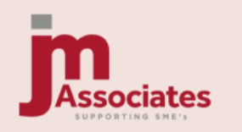
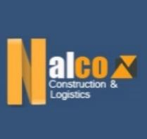
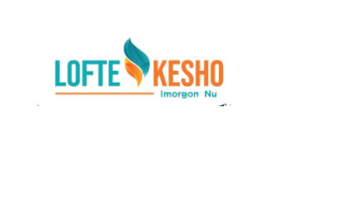
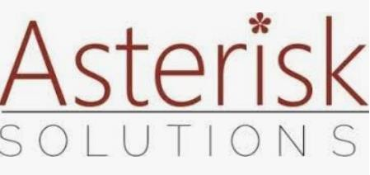
Some of Our Clients
www.rightresource.co.ke

Slide 16
contact us.
Call or WhatsApp: +254 737 416 611/723 211 475
Email: admin@rightresource.co.ke
www.rightresource.co.ke

